Slide 1
The Influence of Conservation Structures on Rangeland Vegetation Patterns
Lauren Thompson
Mentor: Dr. Mary Nichols, SWRC, USDA ARS
Virtual Symposium
4/17/2021

Slide 2
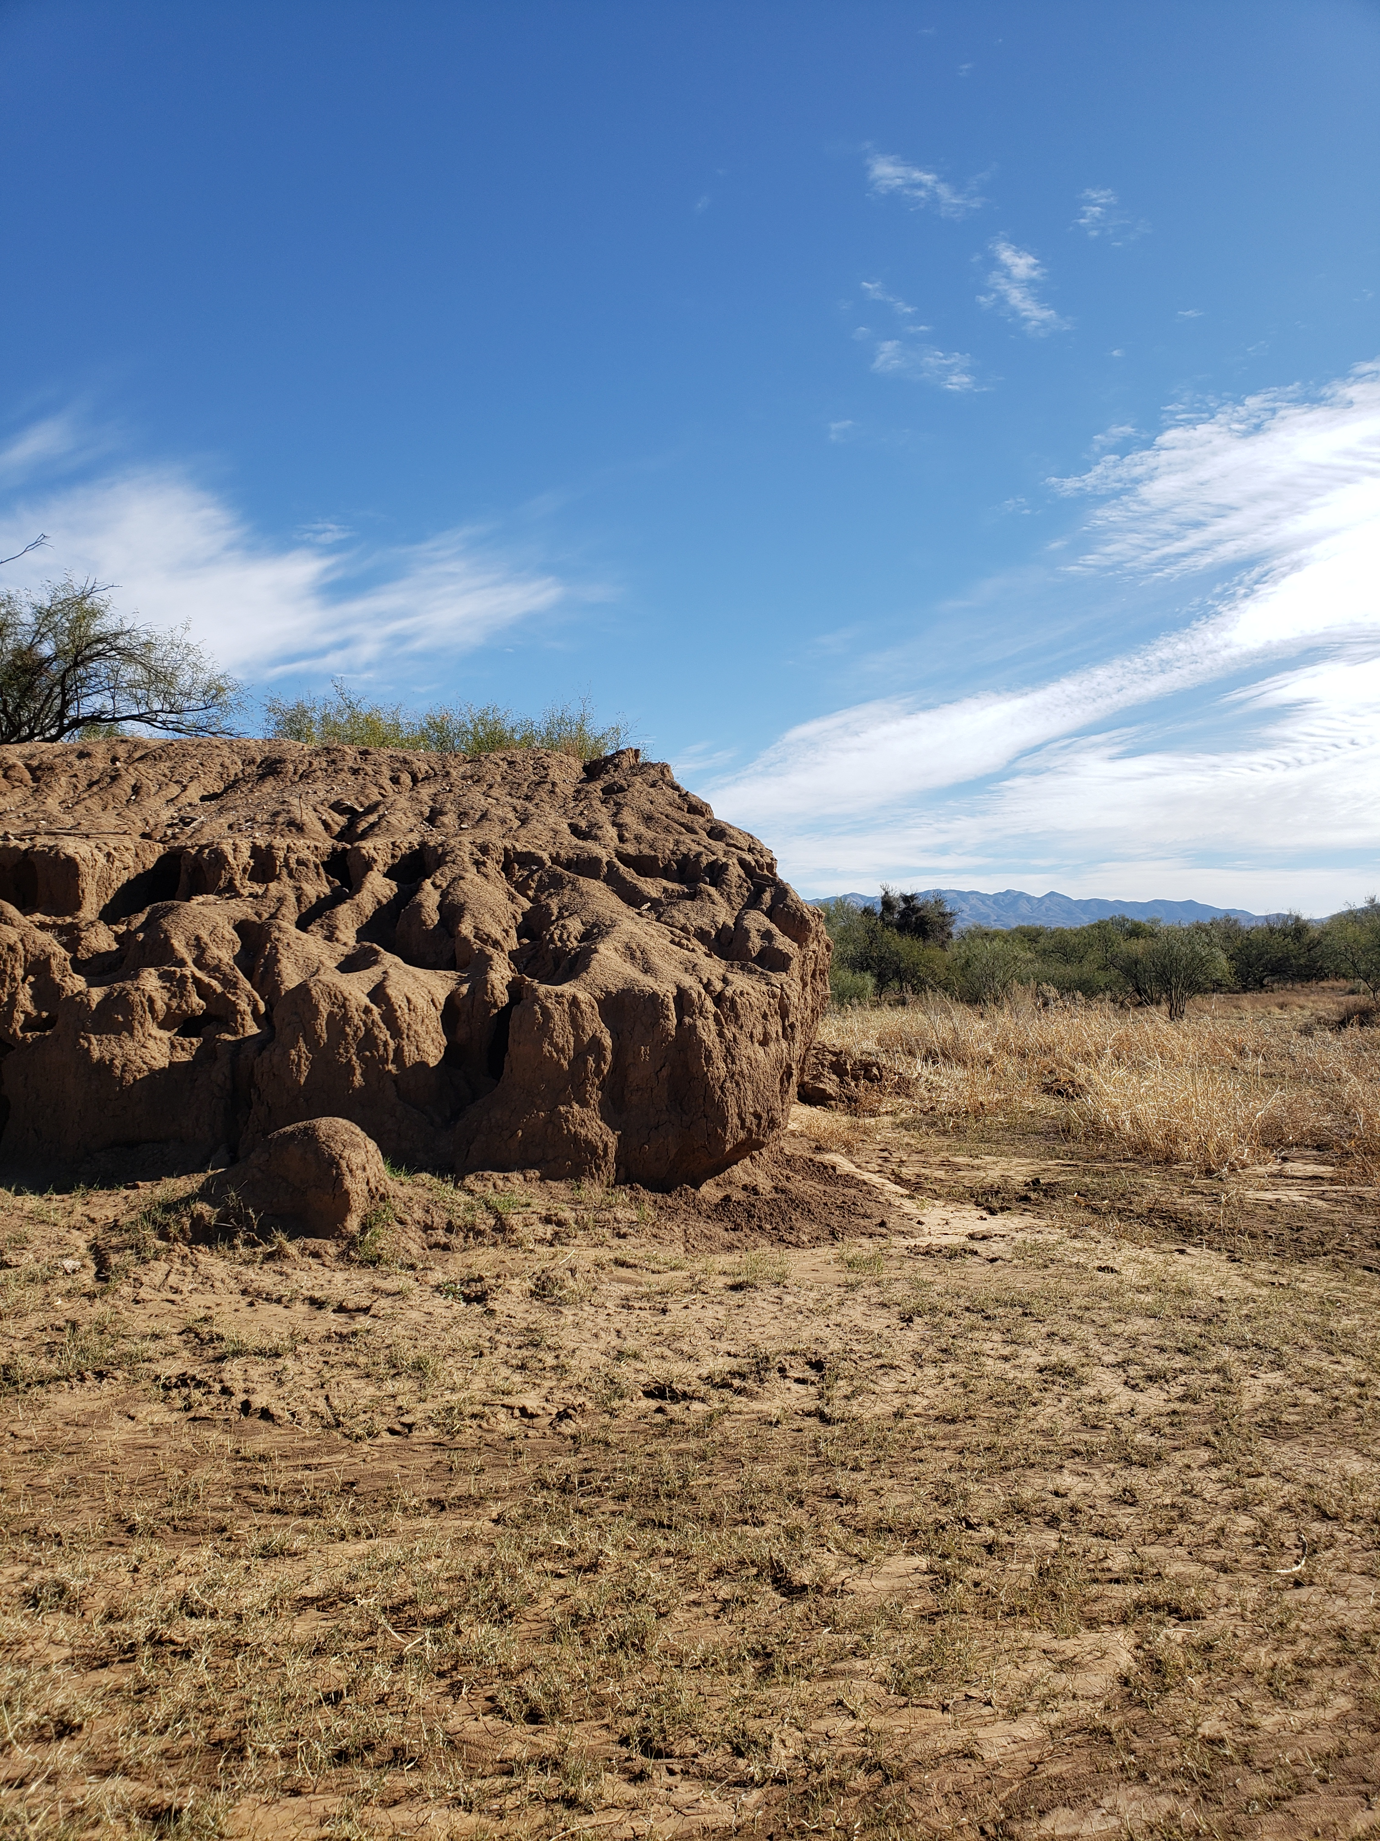
Regional Shifts from Grass to Shrubs
In Arizona, these shifts have been exacerbated by both short-term cycles of flood and drought and longer-term climate changes
Runoff and sediment movement across many rangelands is also altered by earthen berms that are built to capture runoff
We hypothesize that the berms cause differences in upslope and downslope patterns in vegetation and bare soil

Slide 3
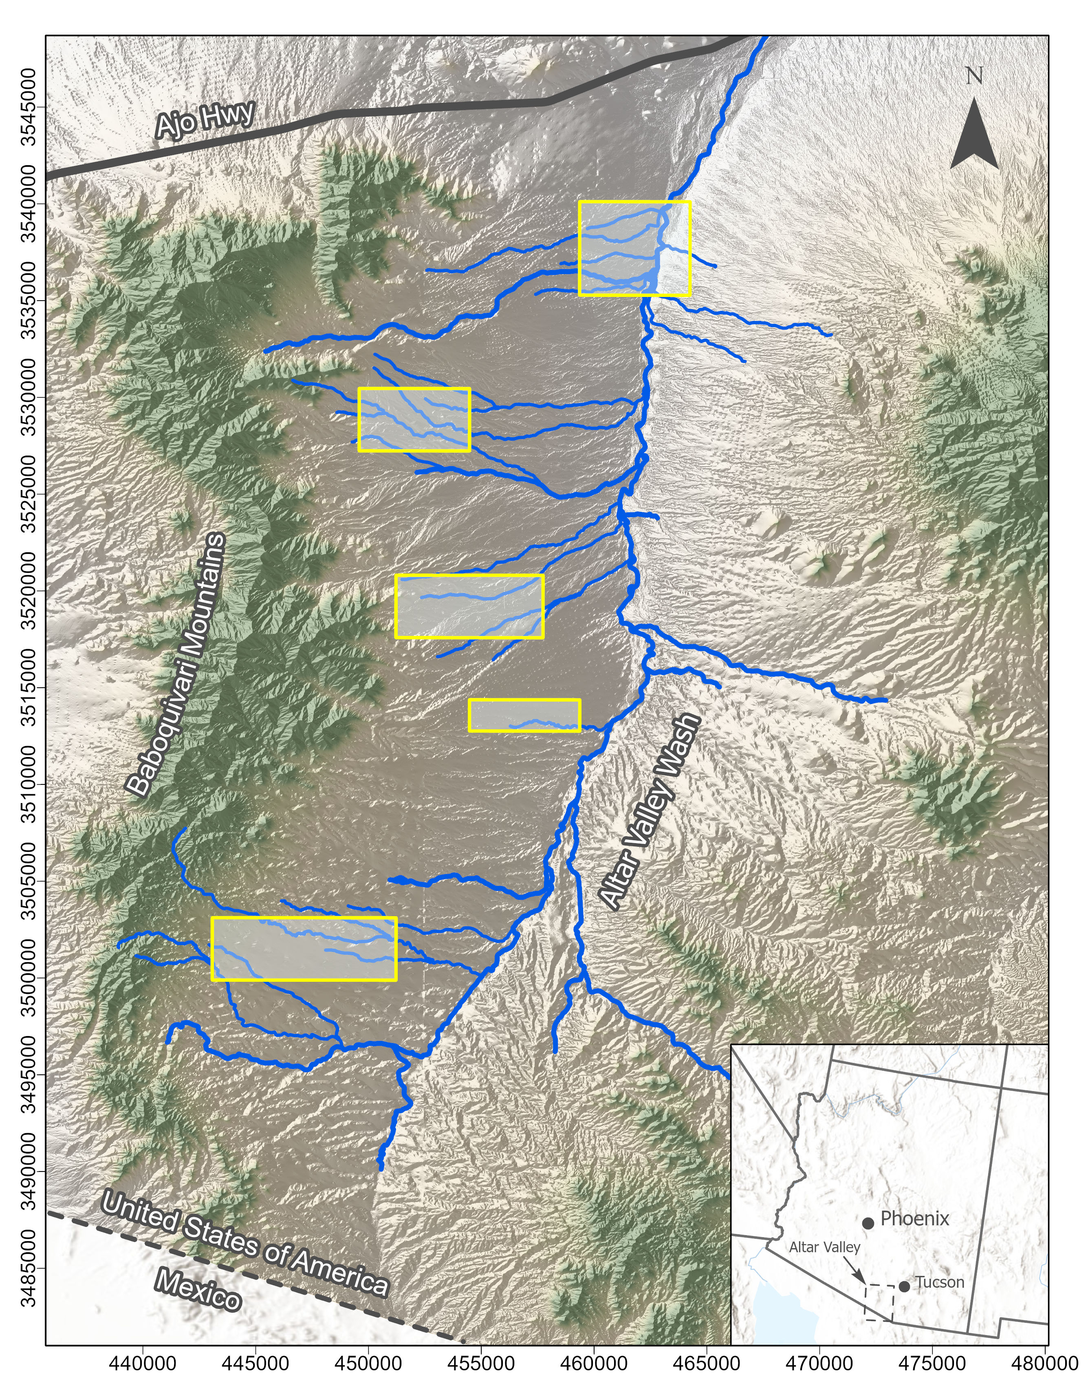
The Altar Valley
Located to the southwest of Tucson, adjacent to the Baboquivari Mountains
The Altar Valley spans approximately 45 miles north to south
Due to limited water sources, the Altar Valley was sparsely inhabited until the late 1800s when wells began to be built
Cattle ranching became the dominant land use in the Altar Valley
Cattle ranchers used conservation structures, such as earthen berms, to capture runoff to promote vegetation growth

Slide 4
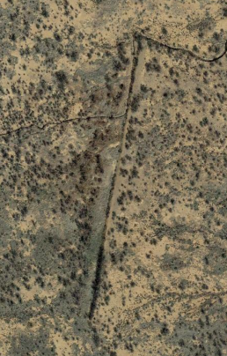
Our Objective
Runoff routed around berm
Flow Direction
To quantify the long-term effects of conservation structures on vegetation patterns in the Altar Valley
Earthen Berm
The earthen berm shown was constructed to capture runoff on the upslope side of the structure
There are visible differences in vegetation on the upslope versus the downslope sides
This berm has been flanked, and runoff is now routed around the berm
Grass and Shrubs
Grass and Bare Soil
Source: Google Earth

Slide 5
Methods
Selected 5 sites for analysis - 4 upland sites and 1 floodplain site
Classified pixels using 2016 orthographic imagery (source: Pima County) within ArcGIS Pro
Classification
Quantification and Analysis
Bare Soil, Grass, Shrub
Created training sets
Applied results to entire site
Performed accuracy check to assess user and system accuracy
Delineated upslope and downslope polygons (6 in total, 3 per side of the structure)
Quantified proportion of each class upslope and downslope of the structures
Performed statistical analyses to compare upslope and downslope proportions of bare soil, grass, and shrubs - in progress

Slide 6
Almost There…
During statistical analysis, it was determined additional data was needed
To account for site specific characteristics that might affect vegetation patterns we added soils information to our dataset
We identified soil types associated with each structure using data collected by the Natural Resource Conservation Service (NRCS)

Slide 7
Preliminary Results
Statistical analysis is still ongoing for areas farther away from the structures
Data below applies to areas adjacent to the structures
We quantified the distributions of area covered by grass, shrubs, and bare soil for 189 structures in 5 sites within the Altar Valley
Class | Upslope (%) | Downslope (%)
Bare Ground | 33 | 52
Grass | 42 | 31
Shrub | 24 | 17

Slide 8
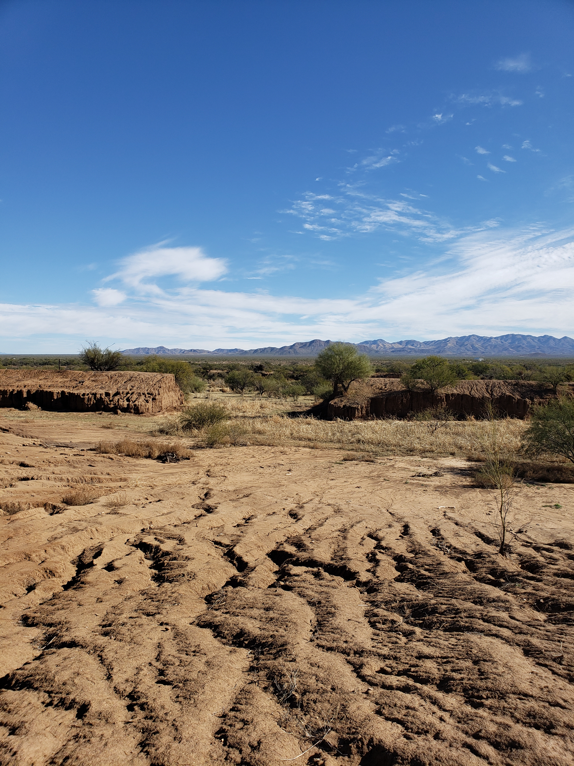
Interpretations
Our data show that earthen berms affect vegetation patterns in their proximity
The data show that there is a higher proportion of vegetation (grass and shrub) upslope, and a higher proportion of bare soil downslope of the structures
These results are important for managing arid landscapes where runoff and vegetation are affected by conservation structures

Slide 9
Acknowledgements
Dr. Mary Nichols
Michelle Cavanaugh
Dr. Chandra Holifield Collins
UA NASA Space Grant Program

Slide 10
THANK YOU!

